Slide 1
RELIABILITY INFRASTRUCTURE FOR LLM APPLICATIONS
Ledger: prove an AI change didn't break anything before users see it.
Live production service:
Team Ethos
https://ledger-21394e.rumptycloud.app/
Record each AI call
Trace cost
Evaluation
Release gate
Notes:
Introduce Ledger: reliability infrastructure for LLM applications that proves changes before production deployment.

Slide 2



THE OPERATIONAL DEFICIT
AI teams ship updates without proof they didn't regress
Spot checks miss failures
Cost hides until invoice
Injection goes unnoticed
Manual spot checks test fewer than ten prompts, missing breaking regressions across long-tail production inputs.
Token and model cost spikes remain completely invisible until the monthly cloud provider bill arrives.
Adversarial payload overrides pass into production pipelines undetected without automated heuristic tagging.
Notes:
Today, production LLM updates run on manual spot checks, silent budget leaks, and unmonitored prompt vulnerabilities.

Slide 3
SYSTEM ARCHITECTURE
Four parts turn runtime activity into release evidence
01
02
03
04
Non-blocking telemetry
Per-span cost attribution
Injection tagging
Automated release gate
Heuristic detection on prompt inputs.
SDK never slows the host app.
Exact token accounting per execution.
Versioned answer evaluation keys block regressions.
Release Gate
Notes:
Telemetry, cost accounting, security heuristics, and golden set evaluations form an unbroken release validation loop.

Slide 4
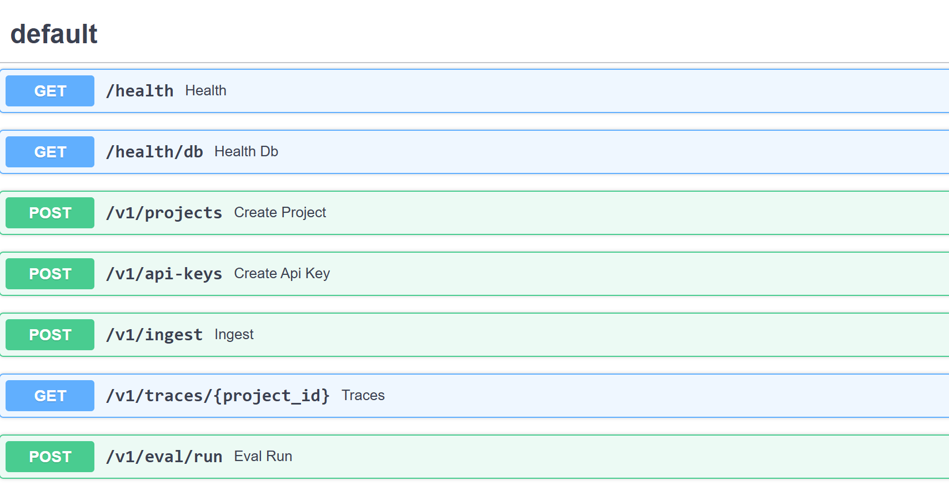
DEPLOYED INFRASTRUCTURE
Criterion 1: Live on Rumpty Cloud
API REFERENCE
PIPELINE RUNTIME
Host SDK →
API (202) →
PostgreSQL →
Worker →
Judge →
Alerts
Managed PostgreSQL job queue buffers incoming telemetry asynchronously.
Interactive OpenAPI spec mounted at /docs
Two processes, one Docker image.
“Running now, not on my laptop.”
Notes:
Criterion 1 is verified live on Rumpty Cloud: an asynchronous ingestion API running in Docker backed by managed Postgres.

Slide 5
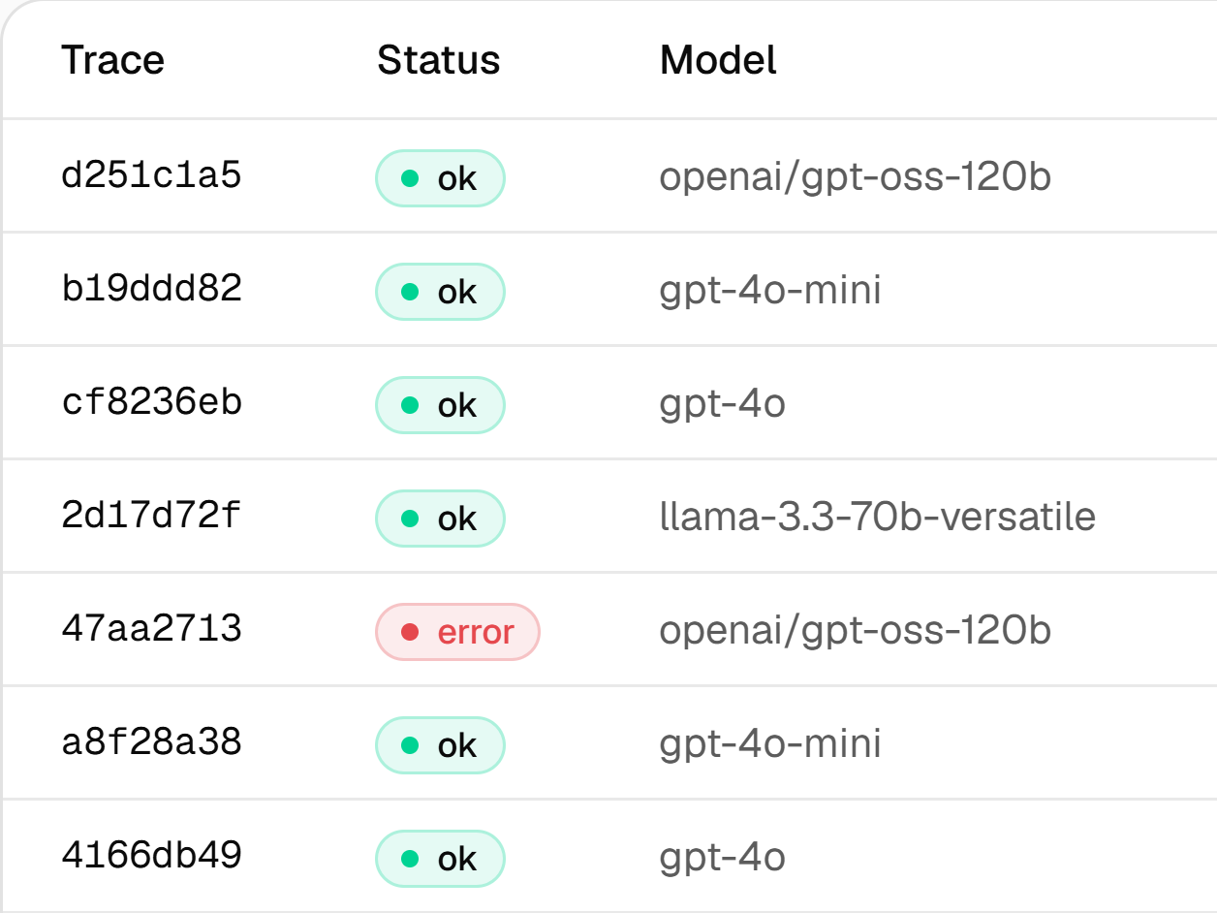
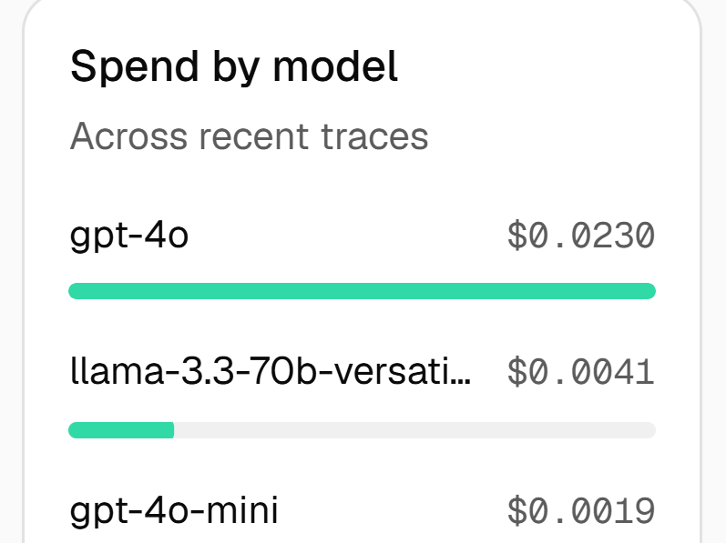
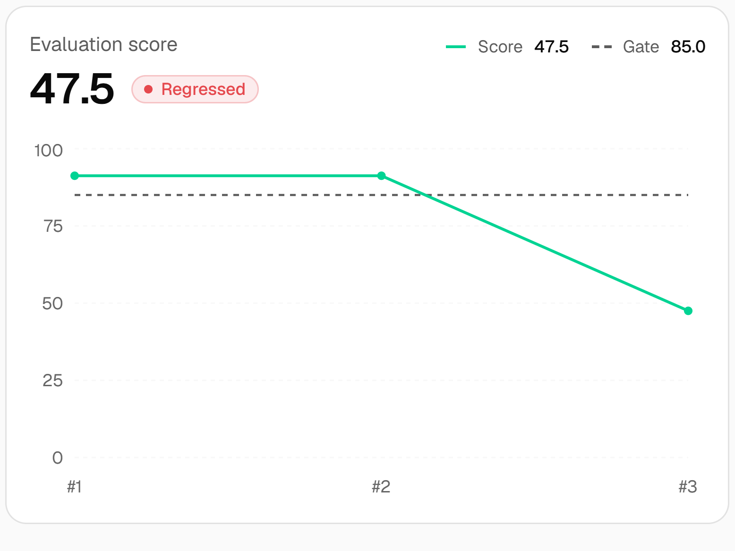
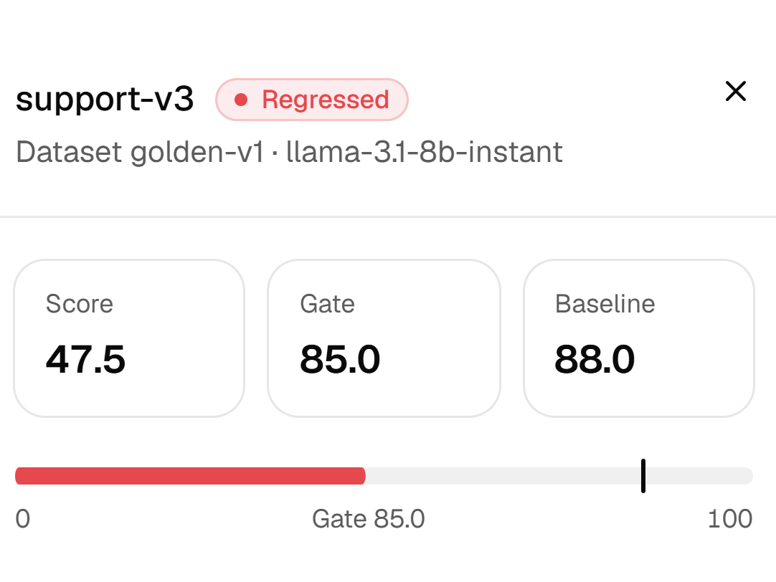
PRODUCT WALKTHROUGH
Demo: from span to release gate
1. Record each AI call
2. Trace cost
3. Evaluation
4. Release gate
Non-blocking SDK transmits spans in sub-millisecond time.
Exact token consumption calculated for every span.
Automated evaluation scores golden test set prompts.
CI checks fail if quality degrades or costs spike.
Notes:
Walk through the four verification stages from span emission to the automated regression gate.

Slide 6
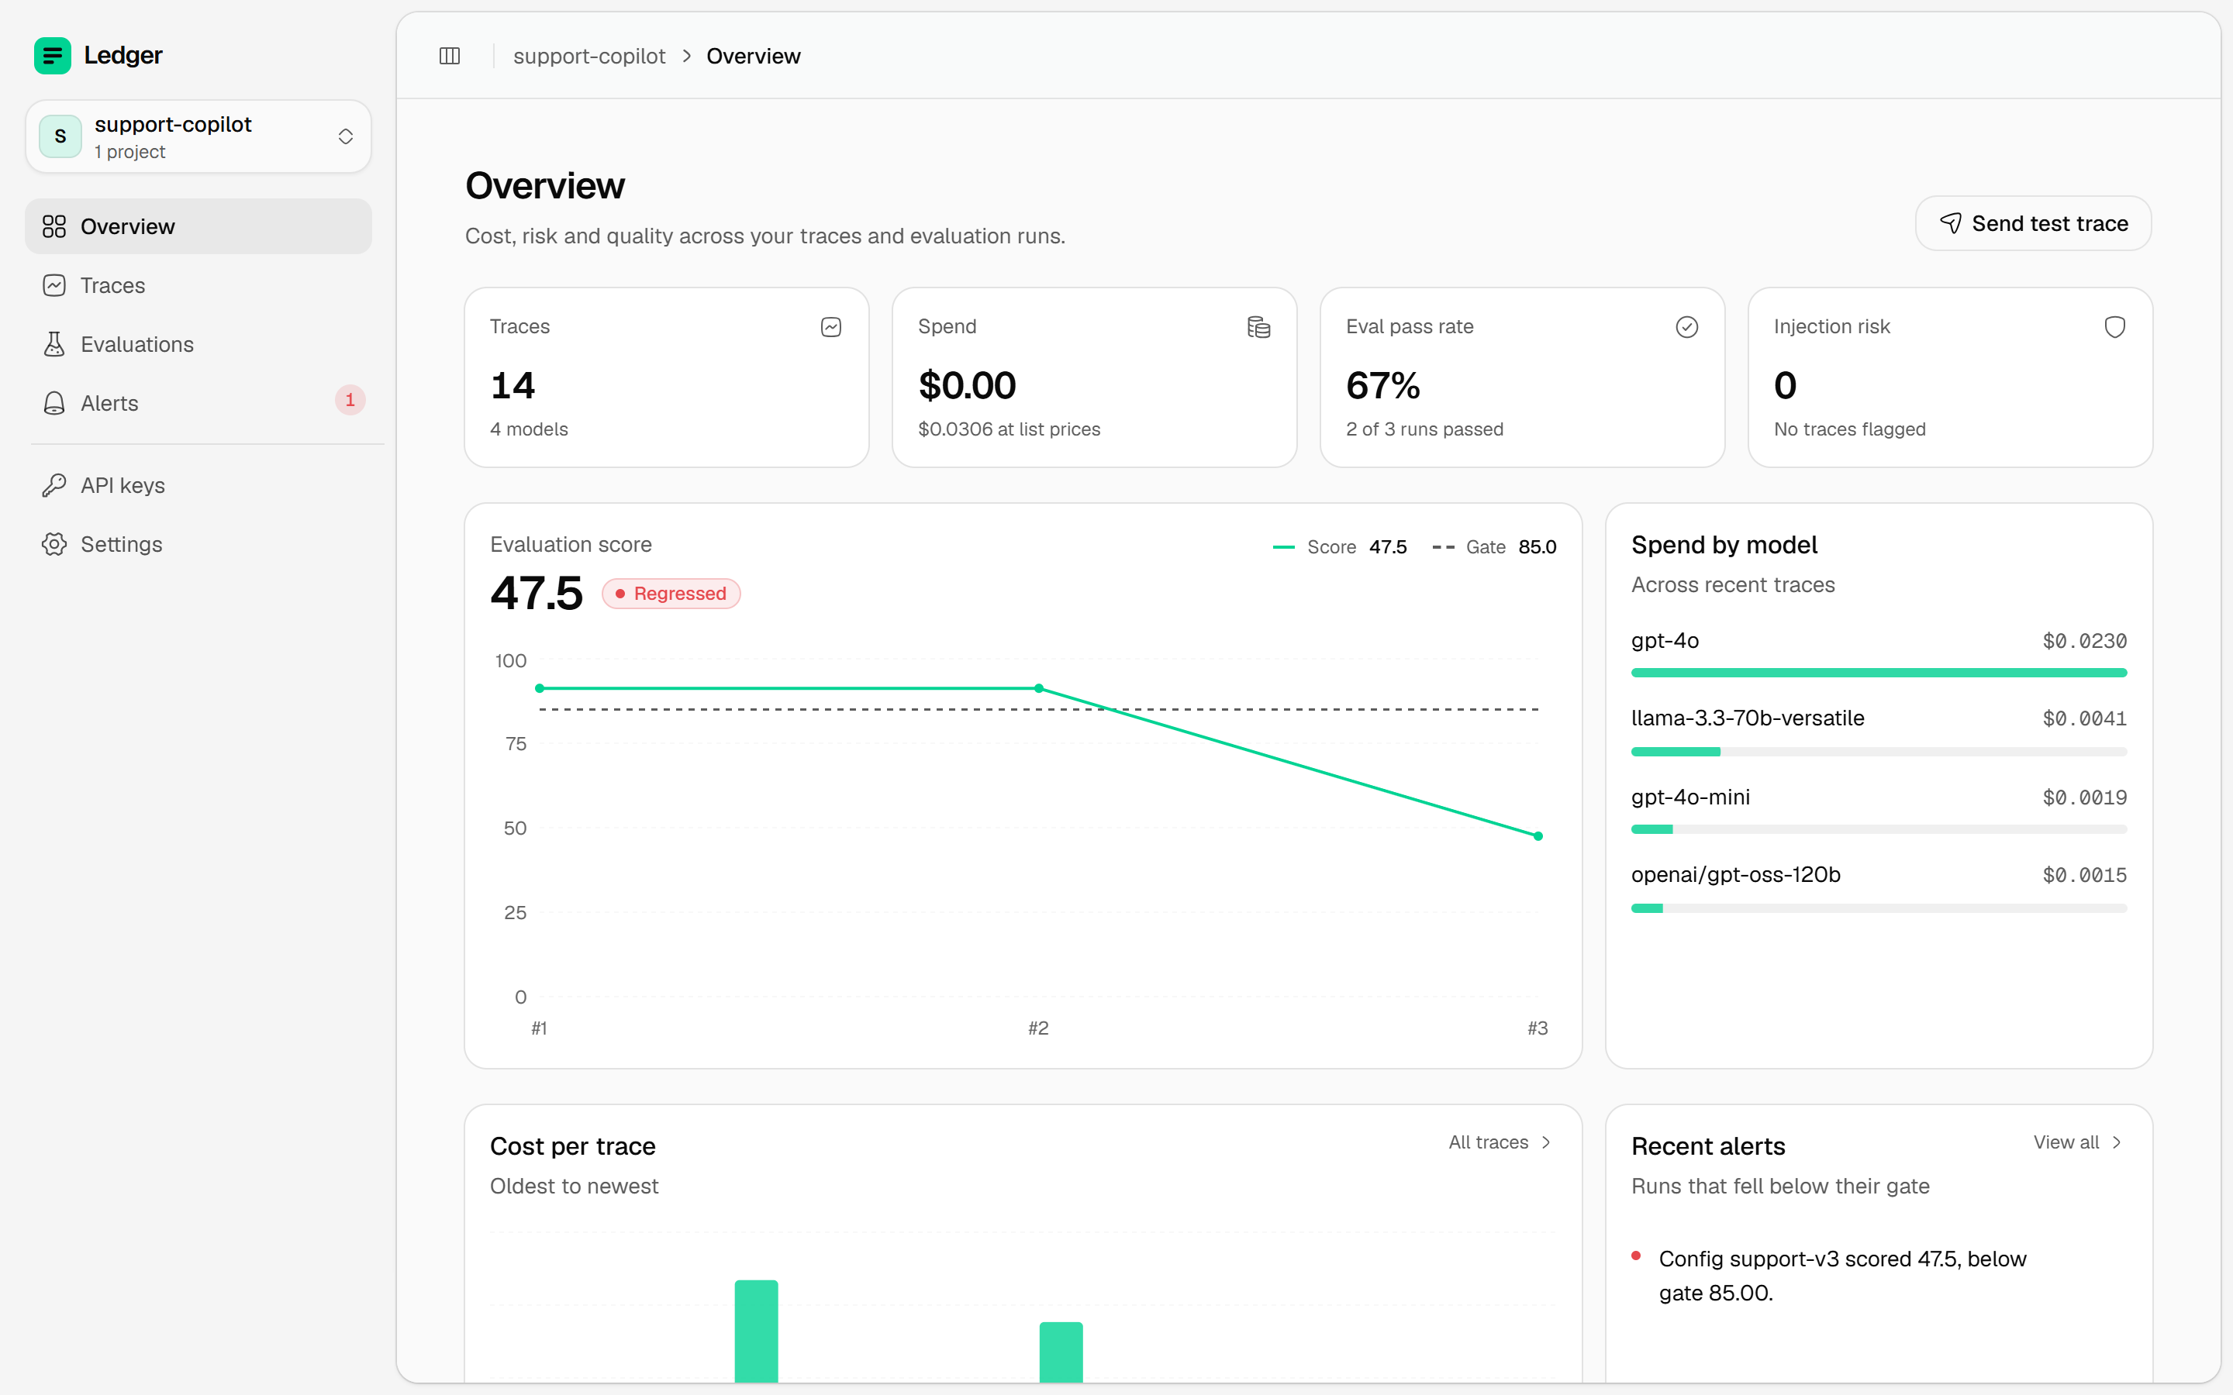
THE DASHBOARD
Cost, risk and quality in one view
Spend by model
Every trace priced at list rates and rolled up per model.
Evaluation gate
Each run is scored against its gate, so a drop is visible at once.
Regression alerts
Runs that fall below their gate surface as alerts.

Slide 7
ENGINEERING INTEGRITY
Criterion 2: Code and documentation
55
96
60 s
Offline tests in CI
Git commits
Offline demo
Passing hermetic test suite
Documented repository history
Zero database or external API keys needed
Frozen API contract
Deployment guide
Deterministic endpoints guarantee stable integration.
Reproducible container instructions run in any standard runtime.
“Another developer can run this.”
Notes:
55 automated tests, 96 commits, and a zero-credential 60-second offline demo confirm reproducible engineering.

Slide 8
AUDITABLE ARTIFACTS
Criterion 3: Release evidence that travels
Commit-bound evidence
Known operational limits
Artifacts bind to exact git commit hashes, container digests, and runtime models. Export and verify offline.
Cost estimates are not provider invoices; export packages remain unsigned; prompt injection tagging relies on heuristics.
Customer validation: not yet started.
Notes:
Evidence bundles tie directly to git commits and containers for portable auditing, while transparently noting current limitations.

Slide 9
EXECUTION ROADMAP
Next 90 days
Day 30
Day 90
Sign each report so nobody can alter it unnoticed
First three pilot design partners integrated in CI/CD.
Day 60
Test new AI versions beside the old one on real traffic and compare
Prove AI changes before users see regressions.
Contact & Diligence
https://ledger-21394e.rumptycloud.app/
Notes:
Our 90-day plan delivers signed packages, shadow traffic evaluation, and three design partner deployments.

